Slide 1
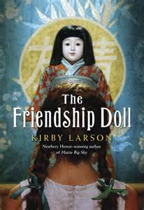
The Friendship Doll
By: Kirby Larson

Slide 2
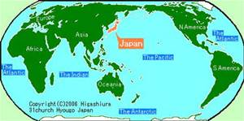
Country of origin
The country of origin of The Friendship Doll is Japan.

Slide 3
Square Miles:
Japan is 145,925 square miles.

Slide 4
Population of Japan
The population of Japan is 126,383,061.
*Fun Fact
Japan is 1.72% of the total world population.

Slide 5
Terrain or landscape
Japan is mostly rugged and mountainous.

Slide 6
Japanese Food
Japanese food includes sushi, rice, tofu, soba, udon, and many other foods.

Slide 7
Things Manufactured
Toyota cars(Toyota city, Japan), and Android electronics.

Slide 8
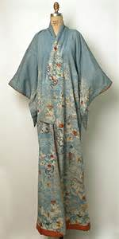
Japanese clothing
In day to day life, the Japanese wear western clothing. On special occasions, they wear traditional Japanese clothing, such as the Kimono. Kimono

Slide 9
Holidays
Some Japanese holidays are New Years, Valentines Day, Dolls Festival (day of the girl), and Showa Day ( birth of former Emperor Showa).

Slide 10
Religion
The 2 main religions are Shinto and Buddhism.

Slide 11
Country’s main language
The main language is Japanese.

Slide 12
Words or phrases in Japanese
Hi-yaa
Goodbye-sayonora
Good-genki desu
Thank you-arigatou
Your welcome-oou itashi mashite

Slide 13
My book
The Friendship Doll is about a doll named Miss Kanagawa, who is sent with her 57 other “sisters” to America from Japan as Ambassadors of Friendship during The Great Depression.

Slide 14
My book
Along the way, Miss Kanagawa goes from New York to Oregon with some stops along the way. In her
journey, she meets Bunny, Lois, Willie Mae, and Lucy.

Slide 15
My book
Miss Kanagawa learns to accept herself for who she is, not how she looks like. In the book, it says that in the beginning, she would have cared if someone mentioned a smudge on her cheek or something like that. Near the end, she is proud of those scars.

